Slide 1
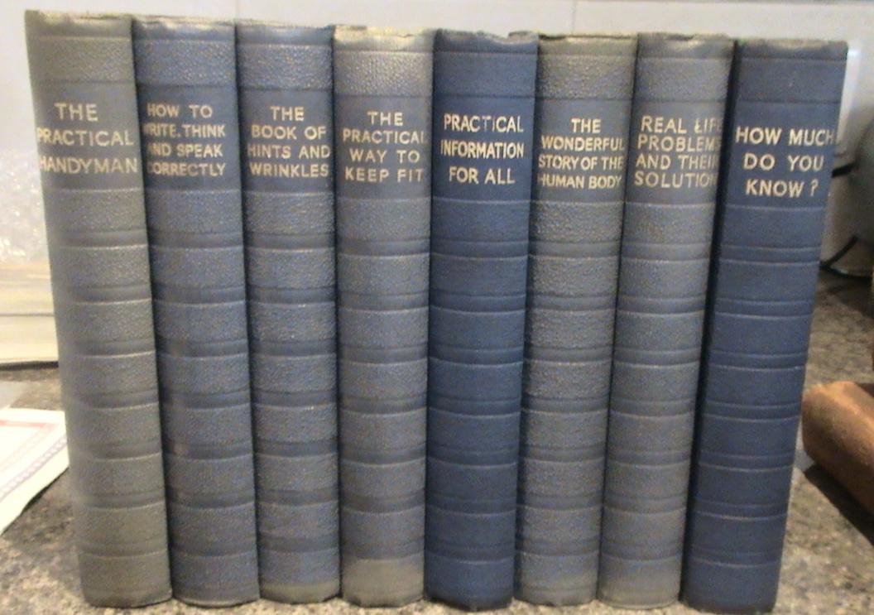

Slide 2
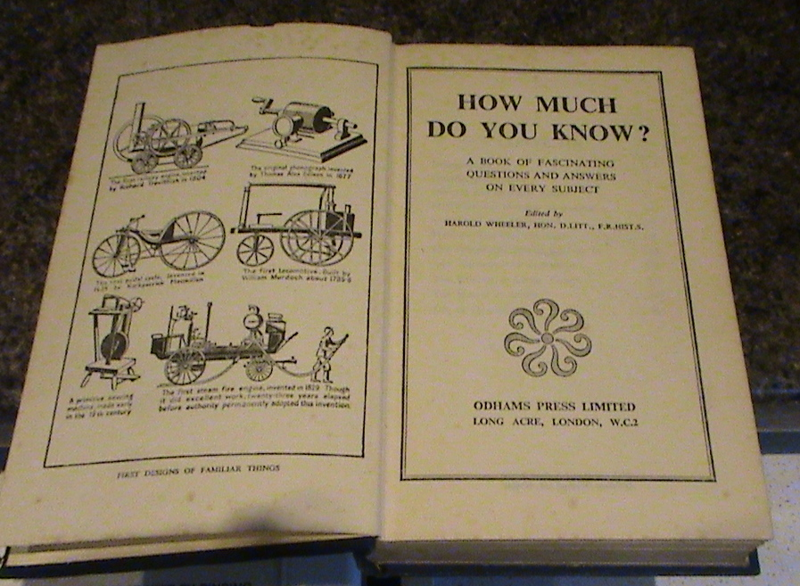
INSIDE ONE OF THE BOOKS. ALL IN SASME CONDITION

Slide 3
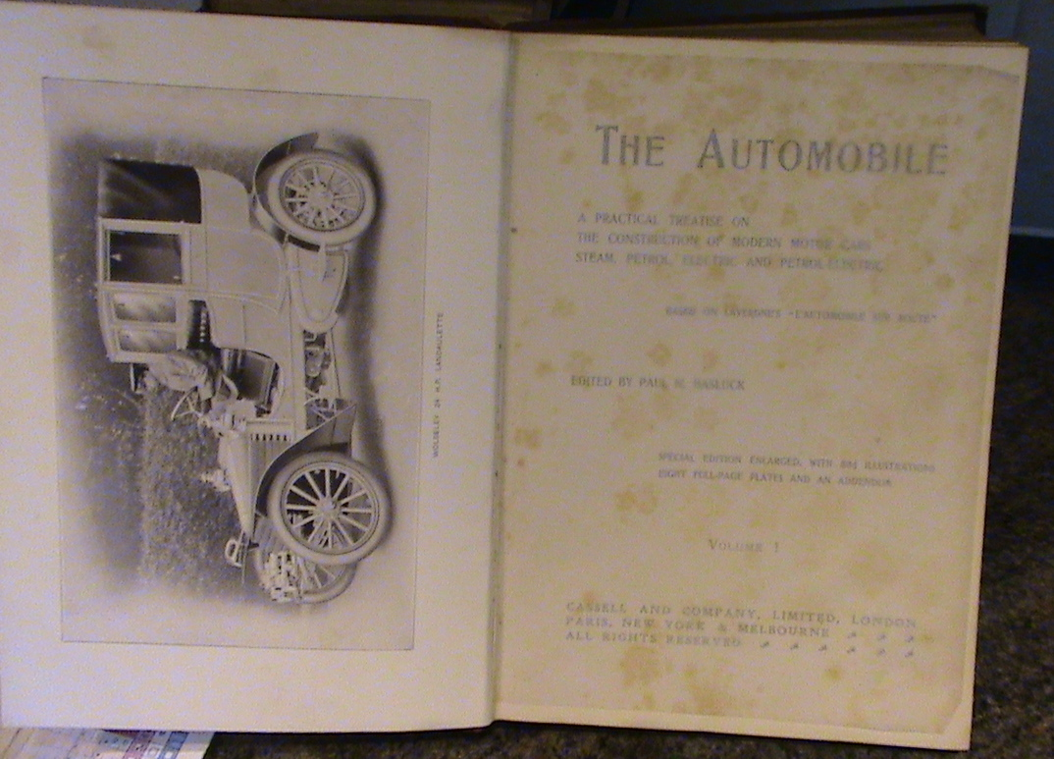
THE AUTOMOBILE
VOL I to III

Slide 4
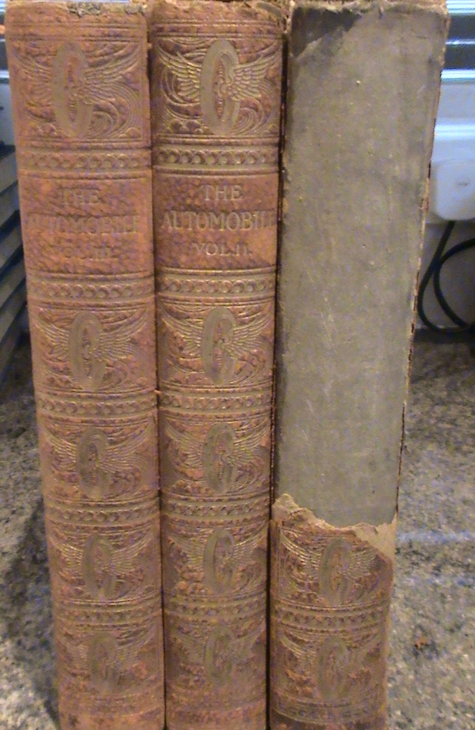
THE AUTOMOBILE
VOL I to III
VOL I SPINE POOR REST GOOD

Slide 5
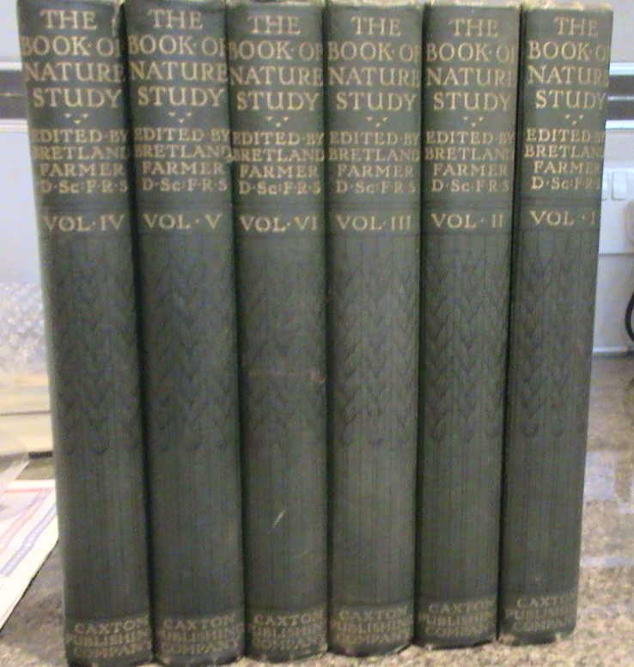
THE BOOK OF NATURE STUDY
VOL I to VI

Slide 6
HOW MUCH DO YOU KNOW
ODHAMS PRESS

Slide 7
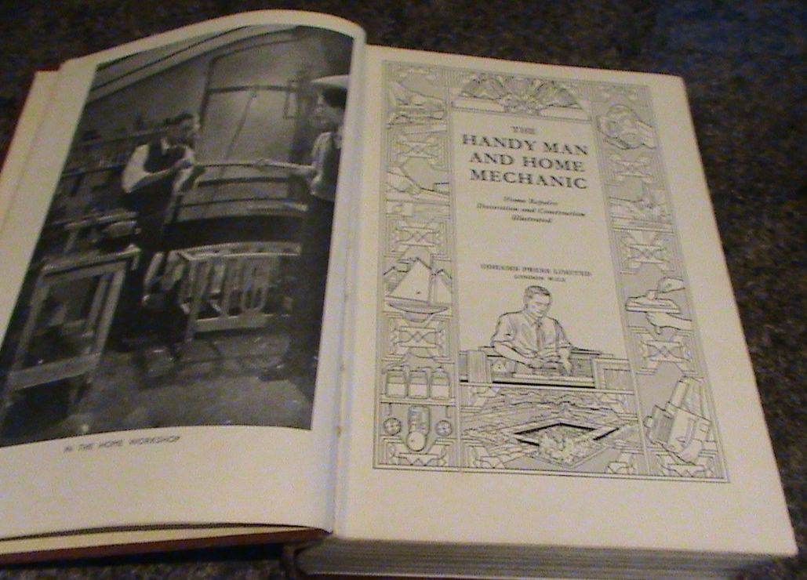
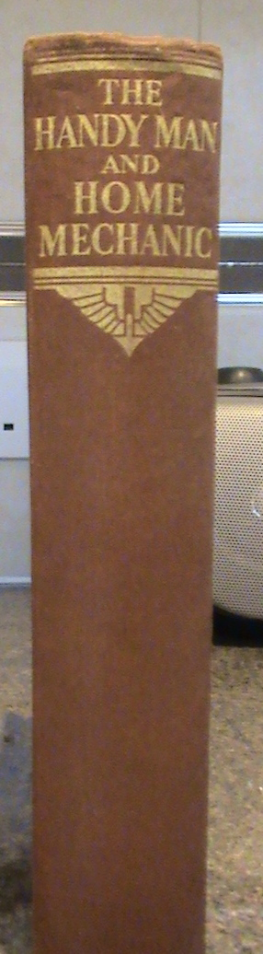
THE HANDY MAN AND HOME MECHANIC
ODHAMS PRESS
Notes:
SET OF TWO WITH THE UNIVERSAL HOME LAWYER

Slide 8
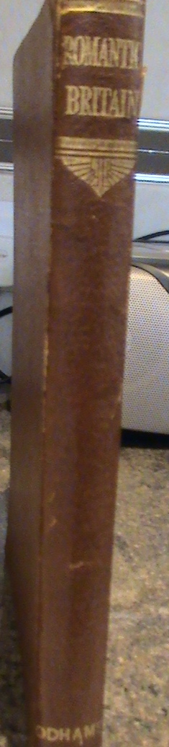
ROMANTIC BRITAIN
ODHAMS PRESS

Slide 9
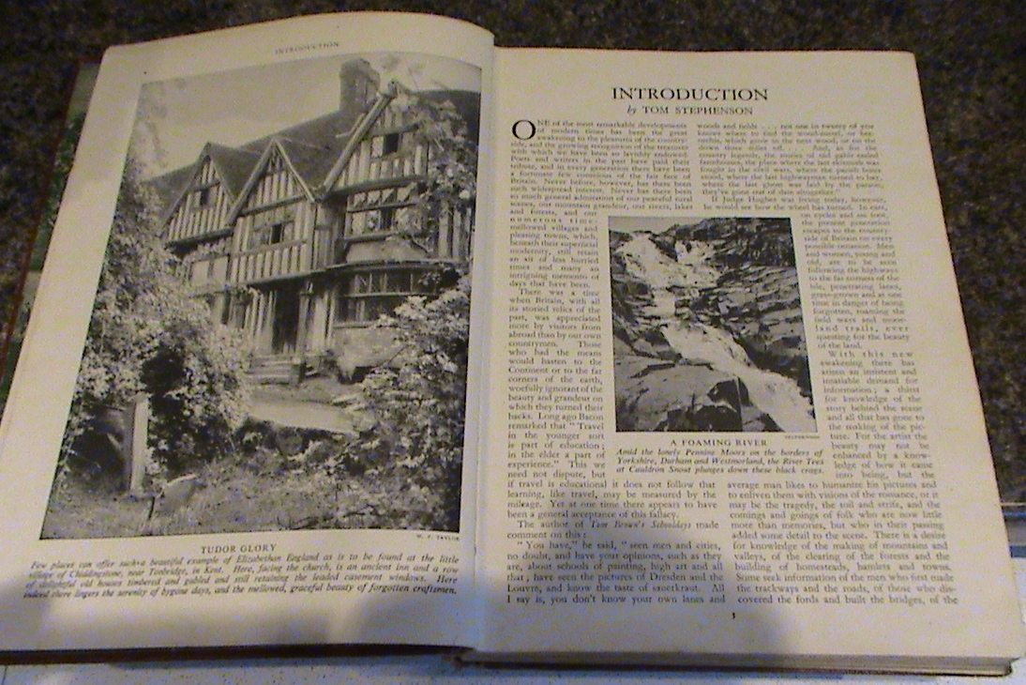
ROMANTIC BRITAIN

Slide 10
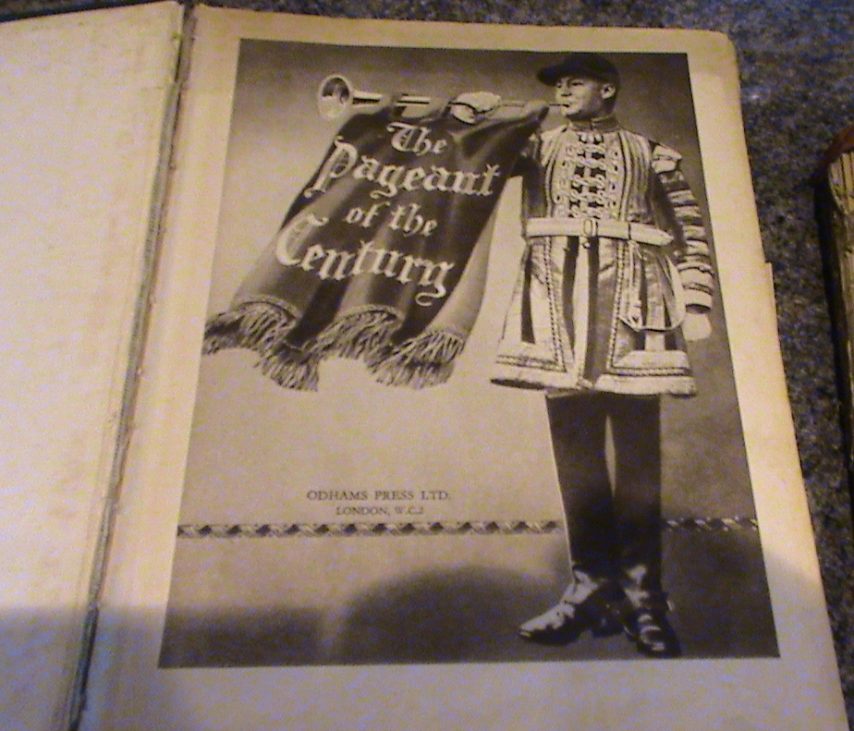
THE PAGEANT OF THE CENTURY
ODHAMS PRESS

Slide 11
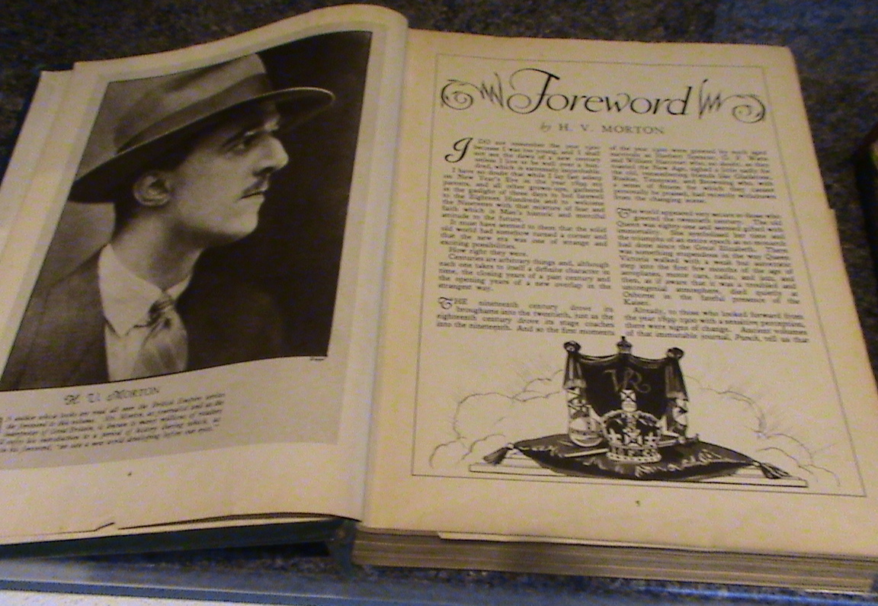
THE PAGEANT OF THE YEAR
FORWARD BY H V MORTON

Slide 12

NICHOLAS NICKLEBY
BY CHARLES DICKENS THE AUTHENTIC EDITION [CHAPMAN & HALL]
WITH ILLUSTRATIONS BY PHIZ

Slide 13
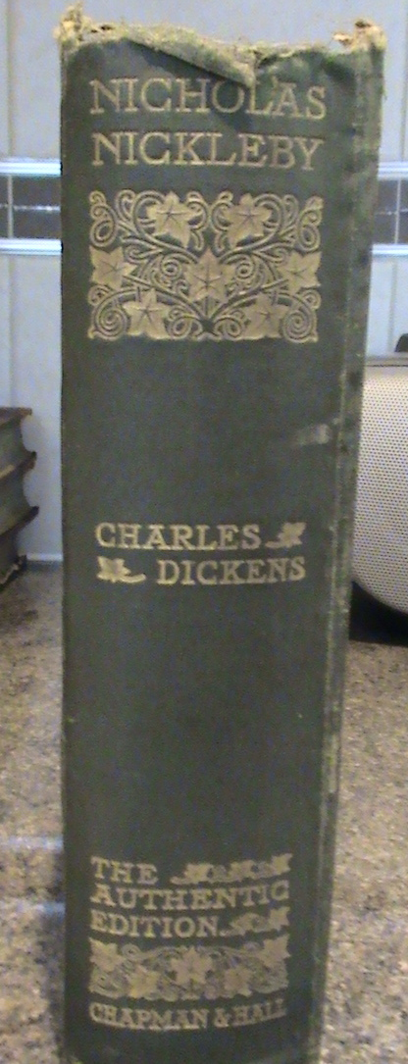
NICHOLAS NICKLEBY

Slide 14
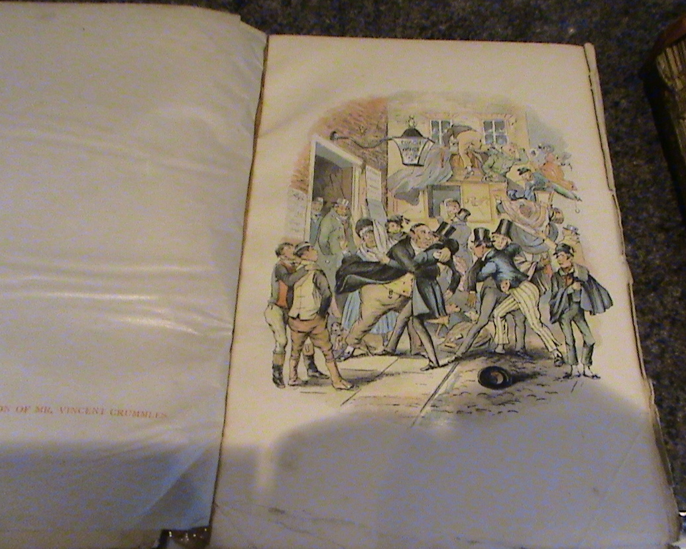
ONE OF THE ILLUSTRATIONS BY PHIZ IN NICHOLAS NICKLEBY

Slide 15
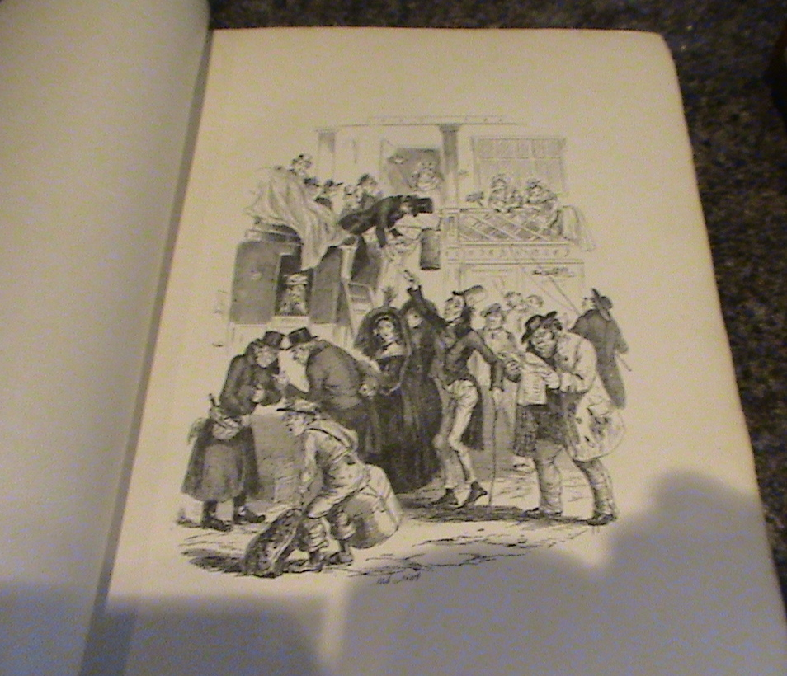
ANOTHER ILLUSTRATION IN NICHOLAS NICKLEBY BY PHIZ

Slide 16
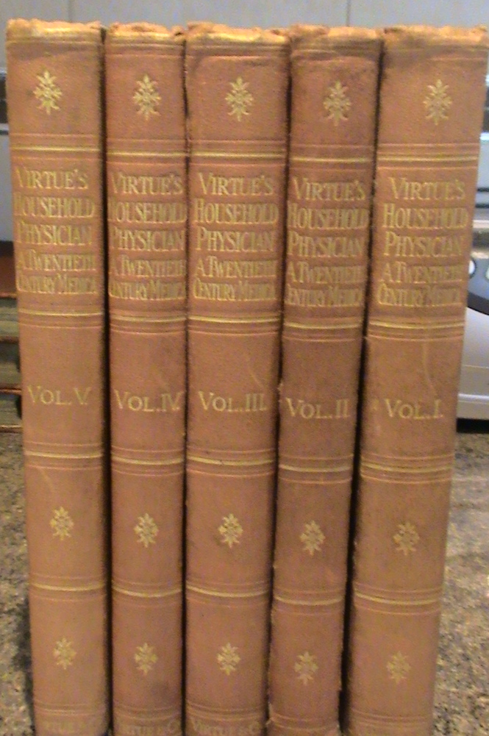
VIRTUE’S HOUSEHOLD PHYSICISN
A TWENTIETH CENTURY MEDICA
VOL 1 to V

Slide 17
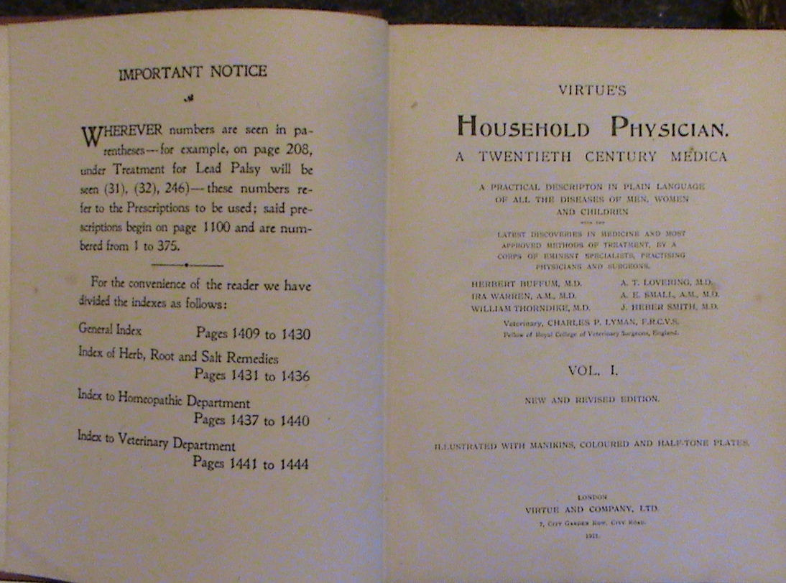
VIRTUE’S HOUSEHOLD PHYSICIAN

Slide 18
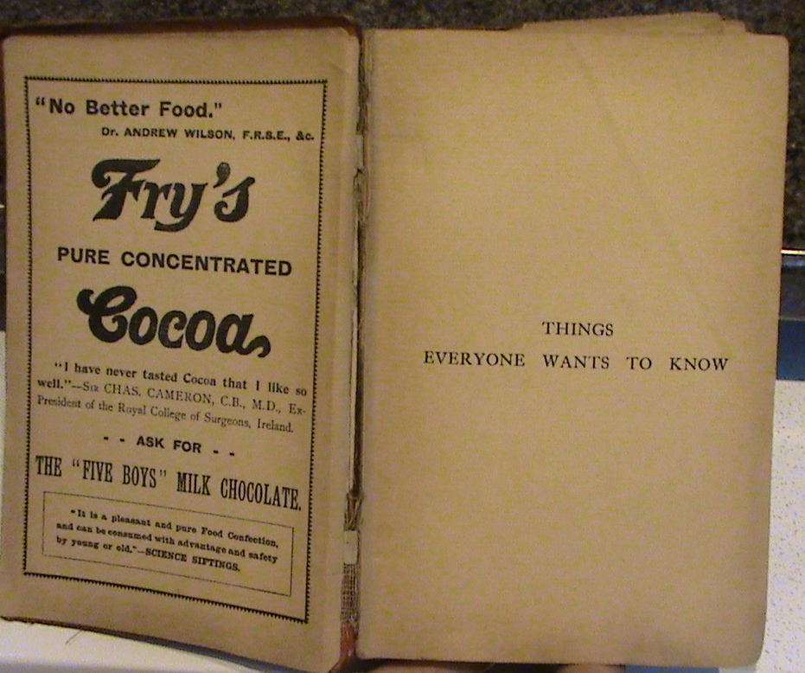
THINGS EVERYONE WABNTS TO KNOW
G ARTHUR PEARSON LTD

Slide 19
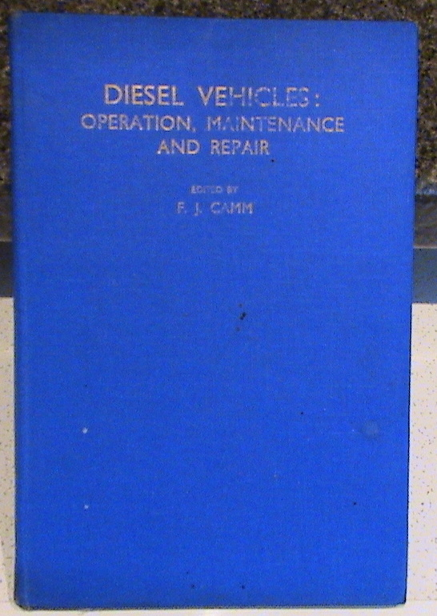
DIESEL VEHICLES
OPERATION, MAINTENANCE AND REPAIR
F J CAMM

Slide 20
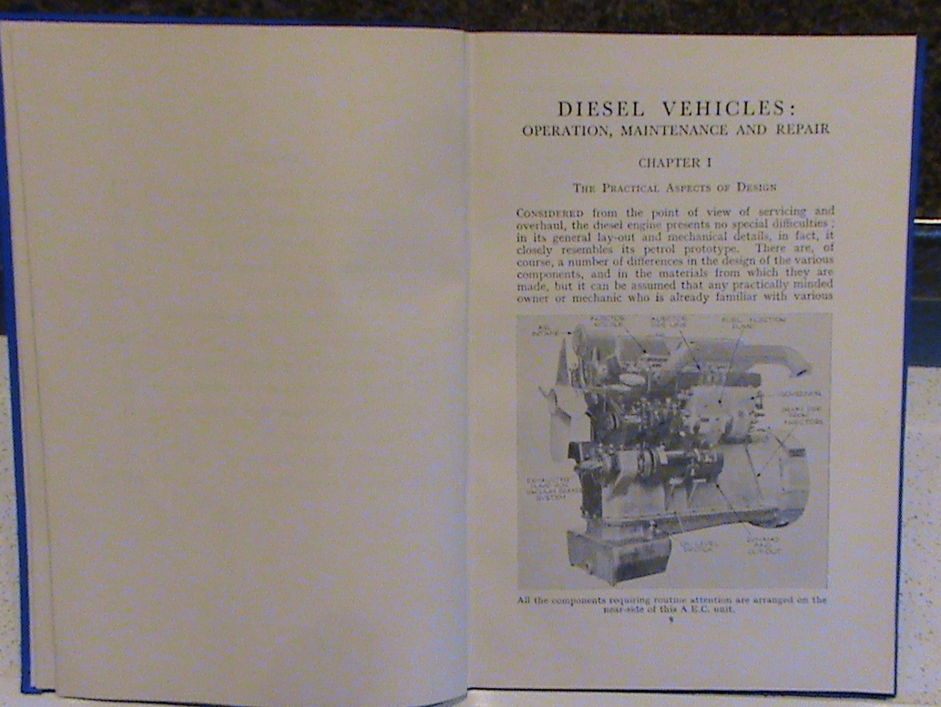
DIESEL VEHICLES INSIDE COVER

Slide 21
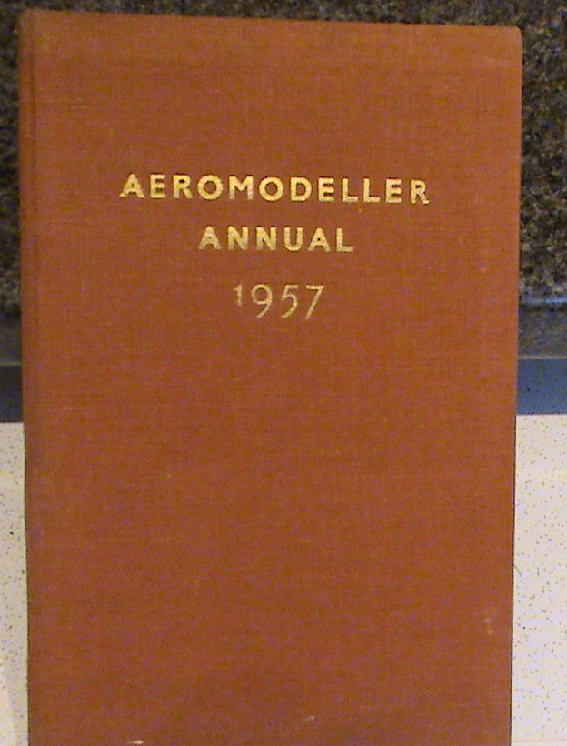
AEROMODELLER ANNUAL 1957

Slide 22
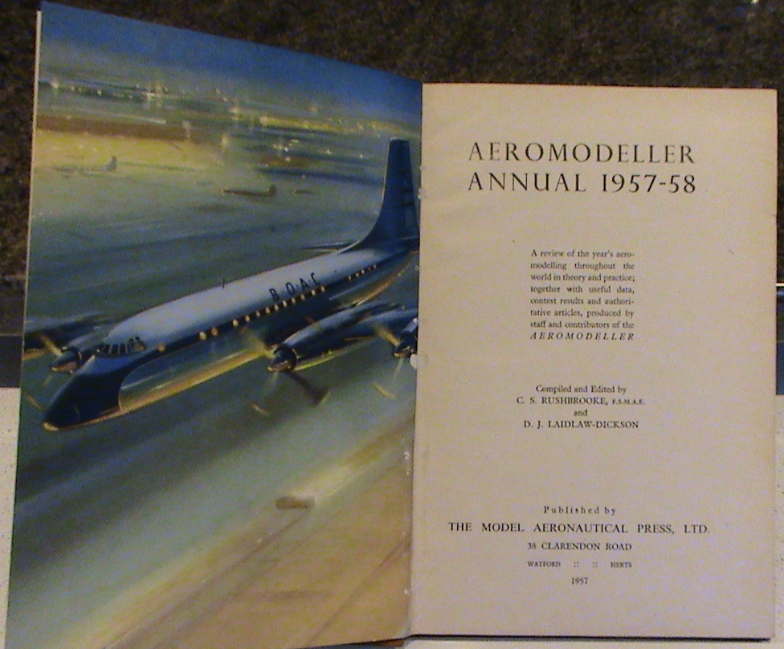
AEROMODELLER INSIDE COVER

Slide 23

JUNE BOOK 1979

Slide 24

SEVENTEENTH BOOK BLUE PETER

Slide 25
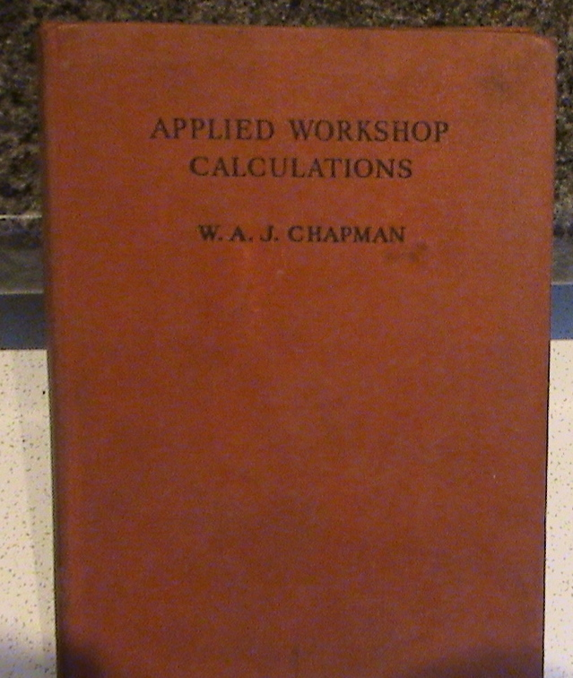
APPLIED WORKSHOP CALCULATIONS
BUTLER & TANNER 1936

Slide 26
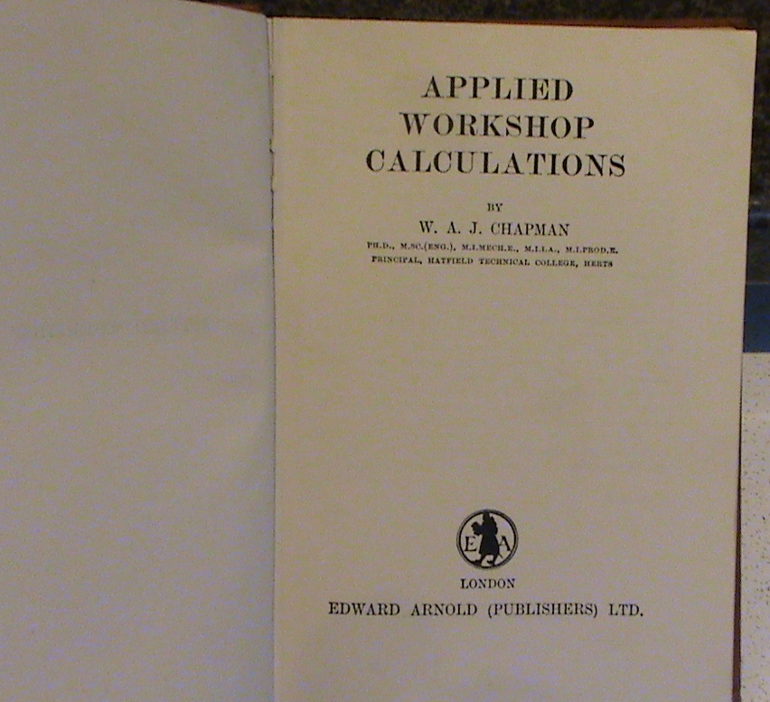
APPLIED WORKSHOP CALCULATIONS INSIDE COVER

Slide 27
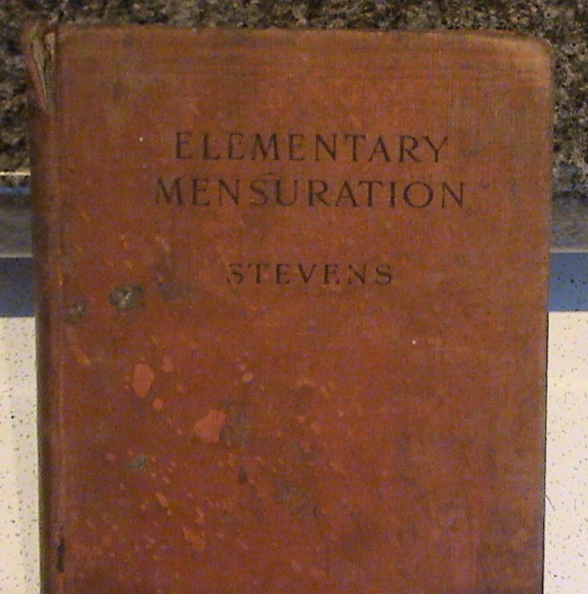
ELEMENTARY MENSURATION – STEVENS
MACMILLAN & CO 1926

Slide 28
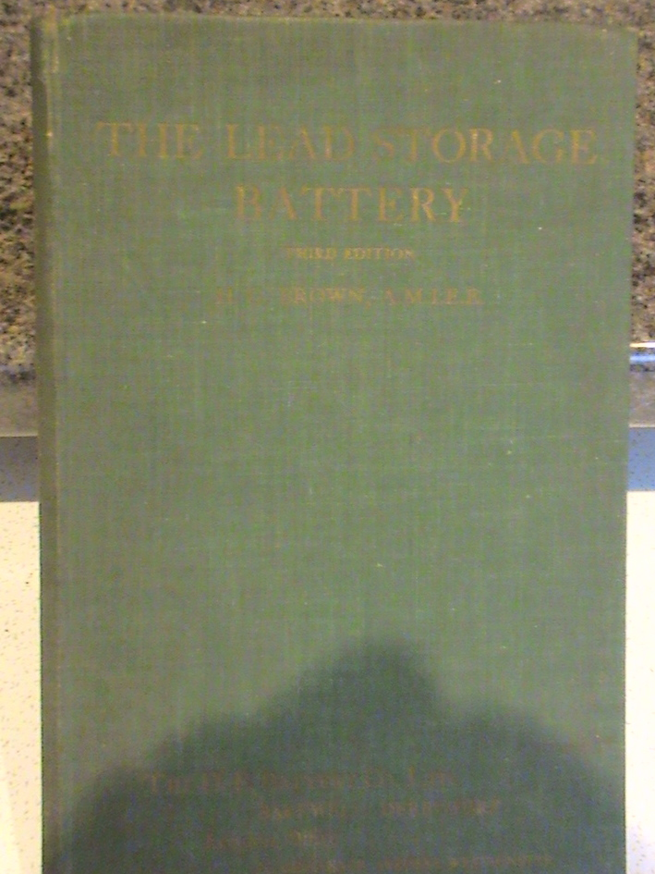
THE LEAD STORAGE BATTERY
THIRD EDITION

Slide 29
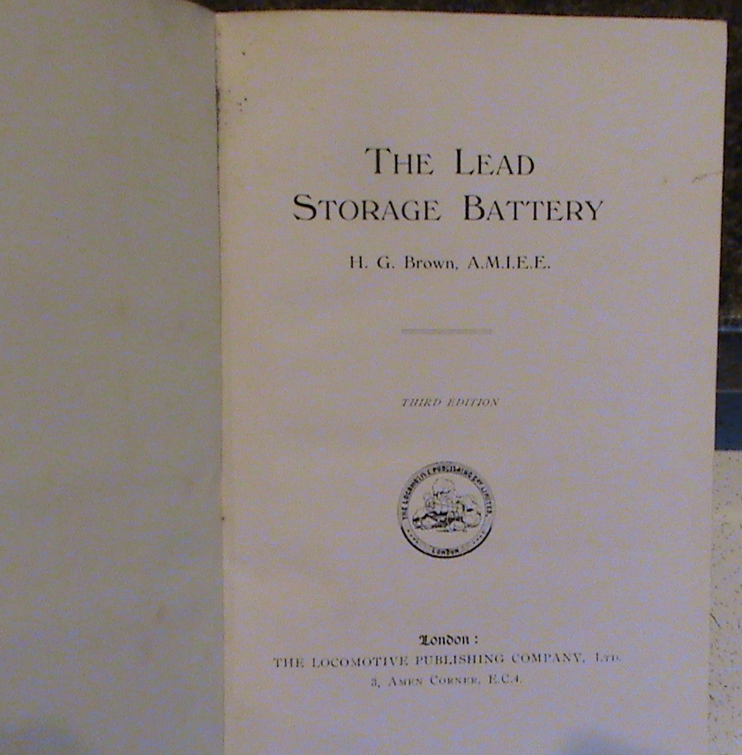
THE LEAD STORAGE BATTERY INSIDE COVER

Slide 30
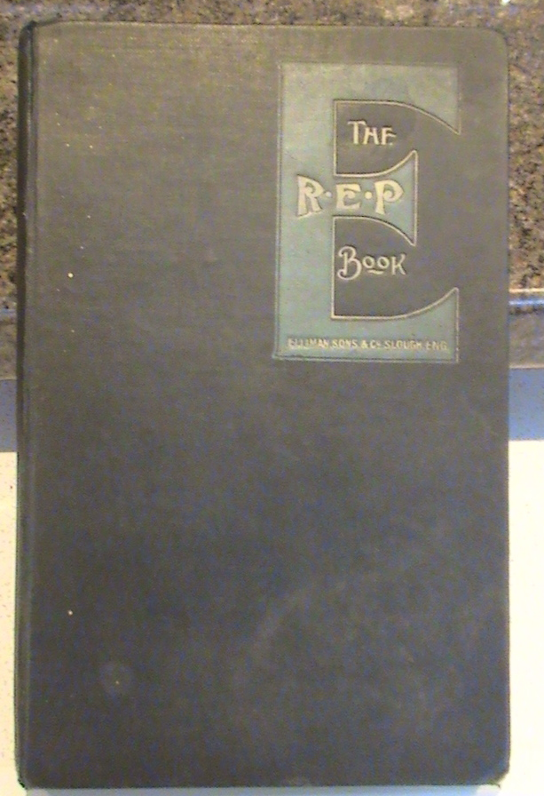
THE R.E.P BOOK
‘RUBBING EASES PAIN’

Slide 31
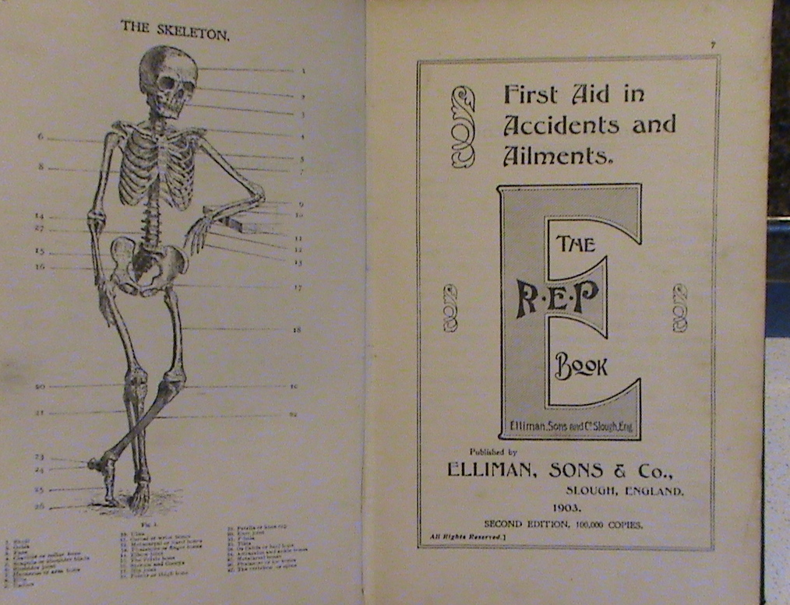

Slide 32
THE R.E.P. BOOK INSIDE COVER 1903

Slide 33
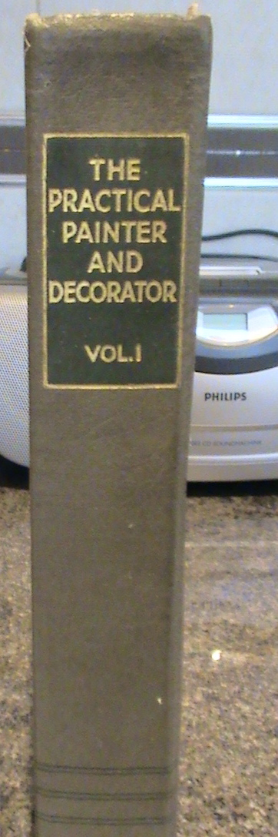
THE PRACTICAL PAINTER & DECORATOR
VOL I

Slide 34
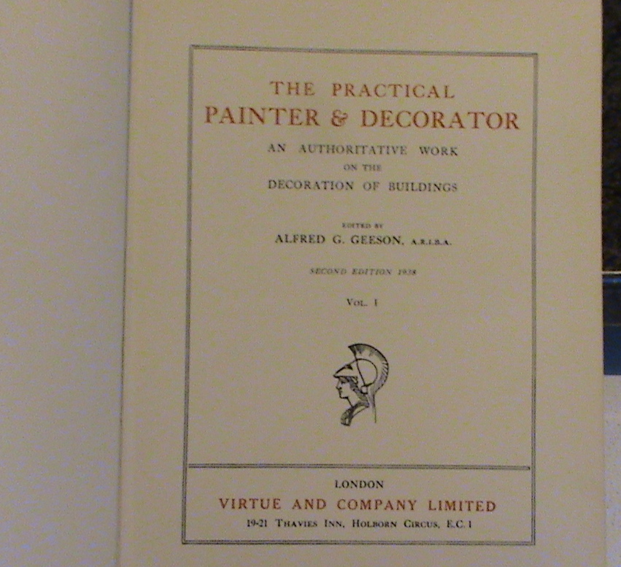
THE PRACTICAL DECORATOR
INSIDE COVER

Slide 35
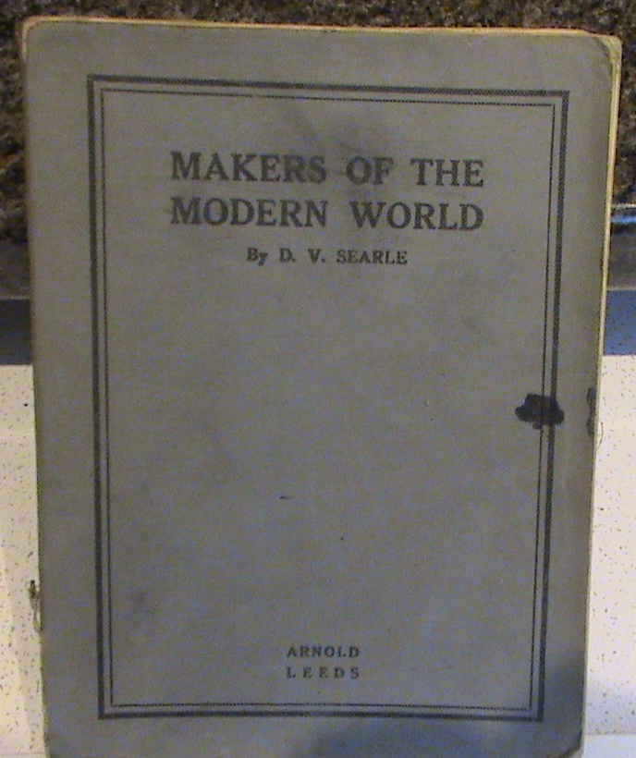
MAKERS OF THE MODERN WORLD

Slide 36
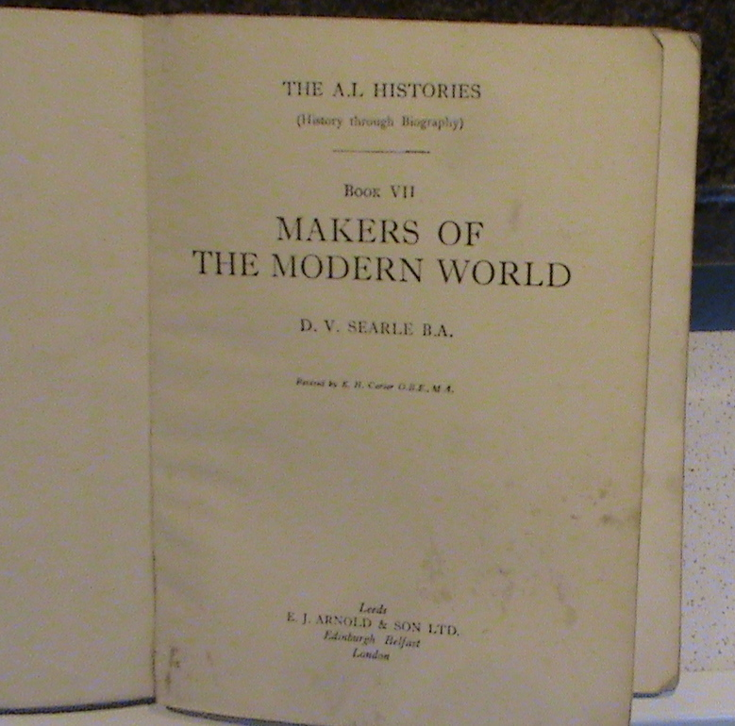

Slide 37
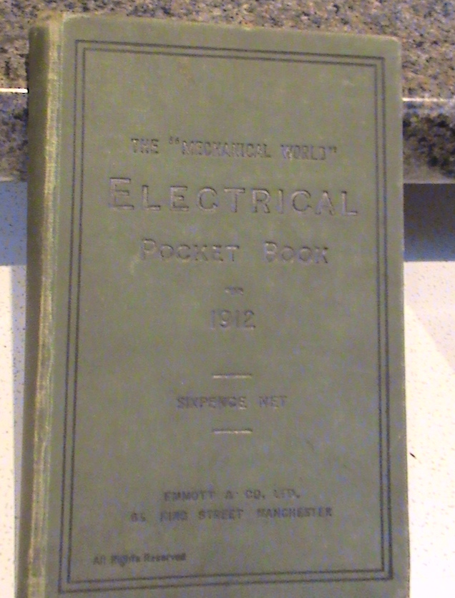
THE “MECHANICAL WORLD”
ELECTRICAL POCKET BOOK
1912

Slide 38
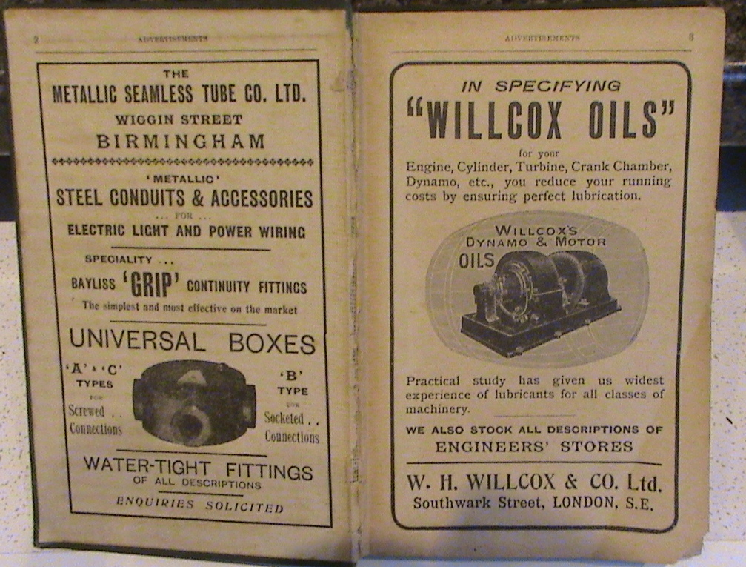
THE ELECTRICAL POCKET BOOK 1912
INSIDE COVER

Slide 39
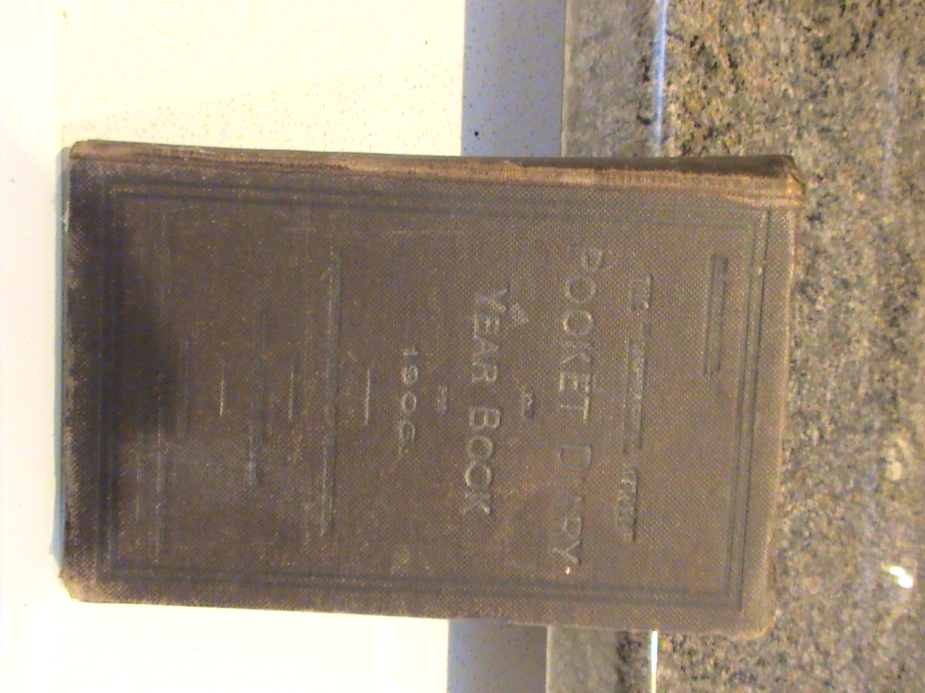
THE “MECHANICAL WORLD”
POCKET DIARY YEAR BOOK 1906

Slide 40
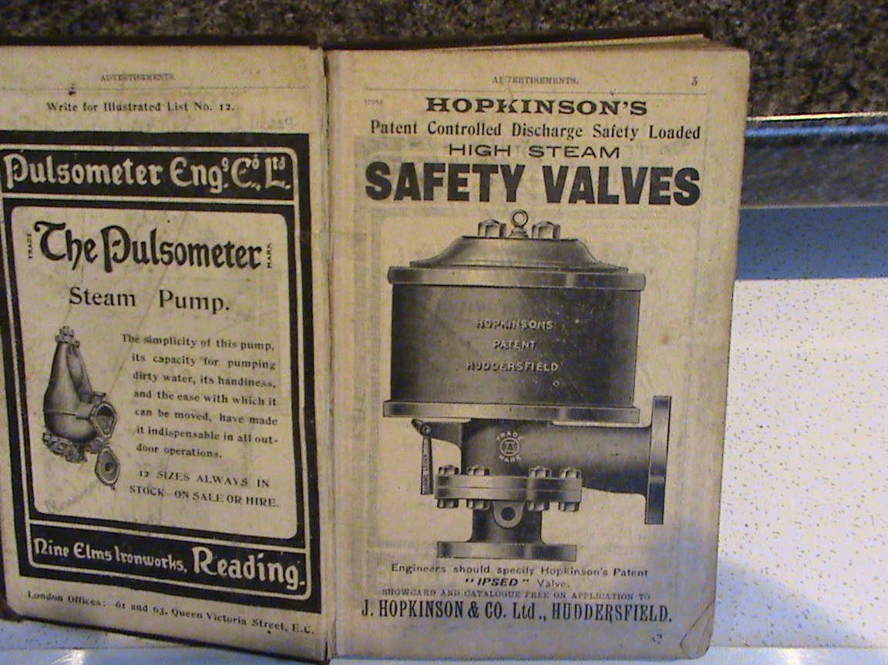
THE “MECHANICAL WORLD”
POCKET DIARY 1906 INSIDE COVER

Slide 41


Slide 42
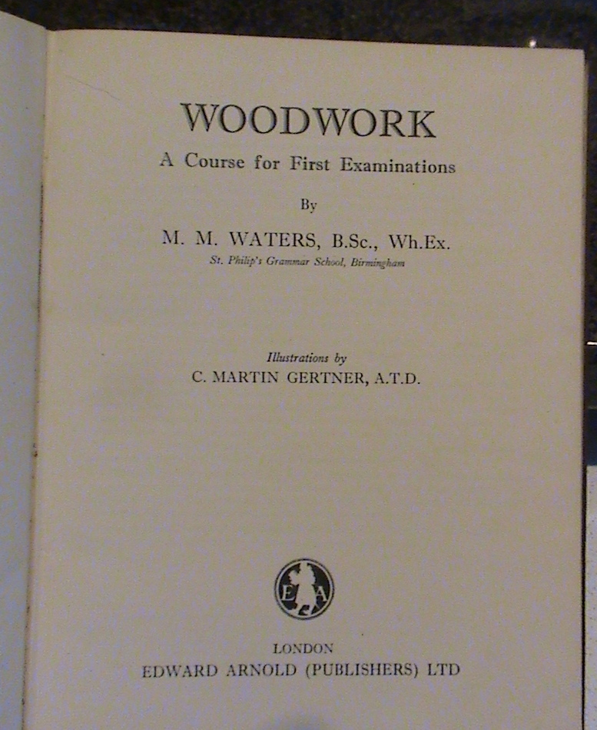

Slide 43
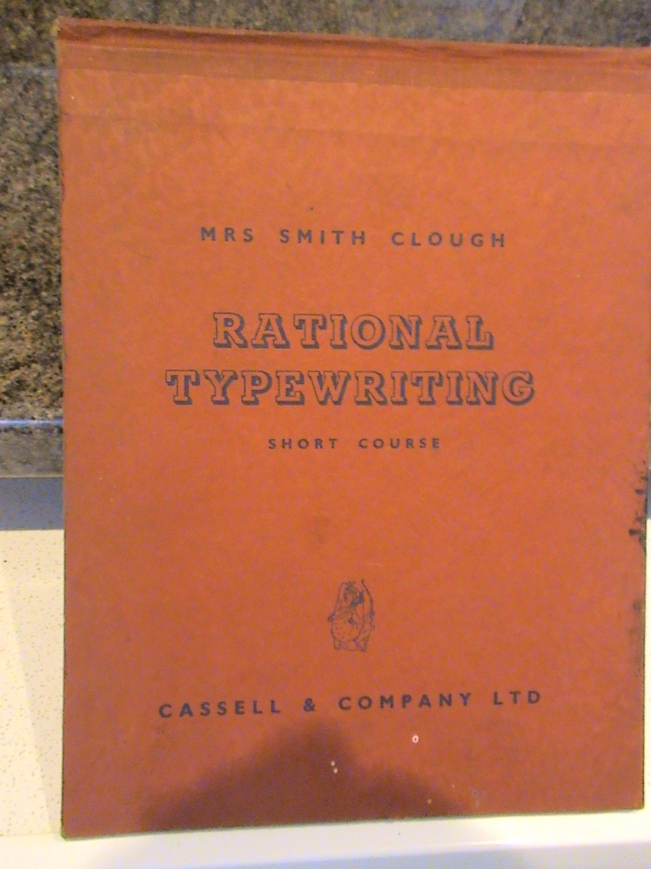

Slide 44
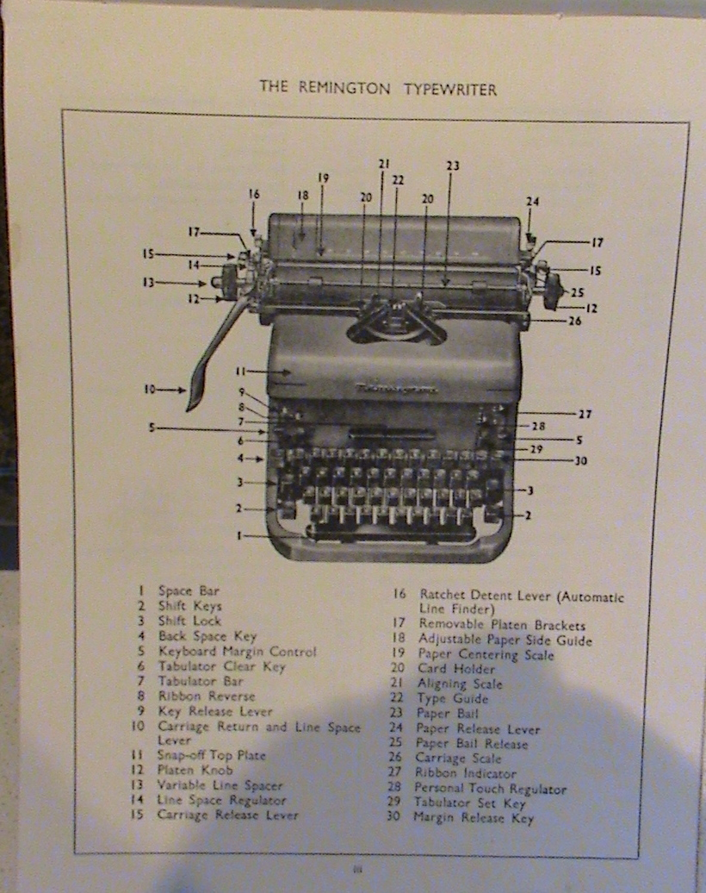

Slide 45
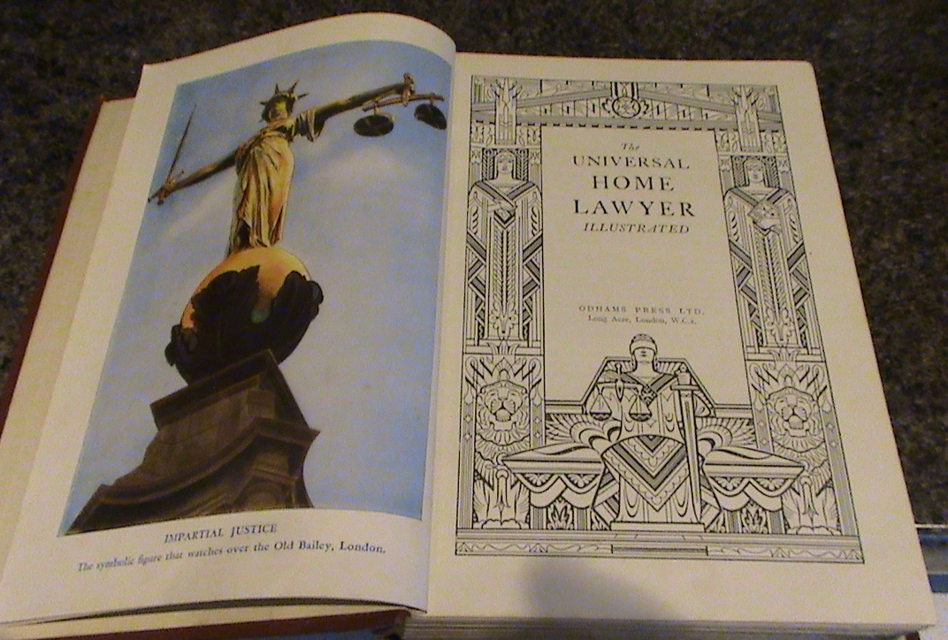
THE UNIVERSAL HOME LAWYER [ILLUSTRATED]
ODHAMS PRESS
Notes:
SET OF TWO WITH THE HANDYMAN & HOME MECHANIC

